Slide 1
Brain To Text: Mapping Intracortical Neural Activity to Text
HY573 Vasileios Feidantsis, Eirini Griniezaki Jan 25, 2026

Slide 2
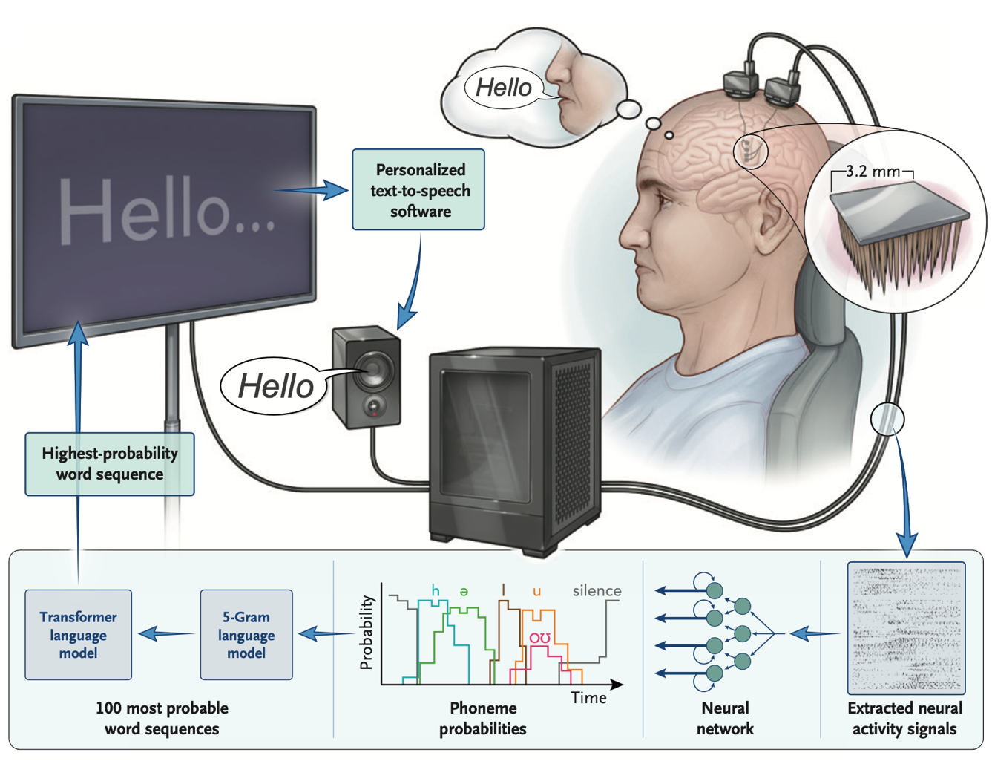
Overview
People with ALS or brainstem stroke can lose the ability to move and speak. Speech brain-computer interfaces (BCIs) can restore communication by decoding what someone is trying to say directly from their brain activity. Once decoded, the person’s intended message can be spoken for them or typed as text on a computer. Following up on prior speech decoding work, it was recently demonstrated that a “brain-to-text” speech BCI can decode the attempted speech of a man with ALS and severe dysarthria into words with 97.5% accuracy.
Decoding Silent Speech

Slide 3
Overview
The Technology: Developing a high-performance Speech Brain-Computer Interface (BCI) that translates neural intent directly into digital text.
The Focus: Leveraging a massive 20-month dataset from 256 intracortical microelectrodes implanted in the speech motor cortex.
The Challenge: Decoding a mixture of attempted vocalized and attempted silent speech across a diverse 10,000+ sentence corpus.
Decoding Silent Speech
September 3, 20XX

Slide 4
The dataset
Corpus | Description
Switchboard | Conversational speech patterns
OpenWebText2 | Natural web-crawled sentences
Harvard Sentences | Phonetically balanced sentences
Random Words | Novel word combinations (tests generalization)
256-channel microelectrode array → 512-dimensional feature vectors (binned spike counts/power)
Variable-length sequences per trial
45 sessions spanning 20 months
September 3, 20XX

Slide 5
The pipeline
Technique | Our Implementation
Gaussian Smoothing | σ = 30ms temporal smoothing (reduces spike jitter)
Robust Scaling | Median/IQR normalization (handles outliers)
Temporal Masking | 15% of time steps masked (SpecAugment-style)
Channel Masking | 15% of channels masked (prevents over-reliance on single neurons)
Session Adaptation | SubjectAdapter layer with per-session learnable projection matrices
The Problem
The difficulty
Decode variable-length neural time series from 256 microelectrodes into natural language text
Input: High-dimensional spiking activity (512-dim features per time bin)
Output: Transcribed speech (sentences/words)
No ground-truth alignment between neural signals and text (CTC-style problem)
Neural data is noisy and non-stationary. Model must generalize across different speech types without manual intervention
September 3, 20XX

Slide 6
Handling Session Drift
Problem: Electrode signals drift over 20 months (same intent → different neural patterns)
Solution: Subject-Specific Adapter Layer
  Each session gets its own learnable weight matrix + bias
  Maps raw features to a common latent space before the Conformer
  Allows the model to "align" different recording days
class SubjectAdapter(nn.Module):
# Per-session linear transformation: x' = W_session @ x + b_session
weight = nn.Parameter(torch.eye(512) per session) # 45 sessions
bias = nn.Parameter(torch.zeros(512) per session)
September 3, 20XX

Slide 7
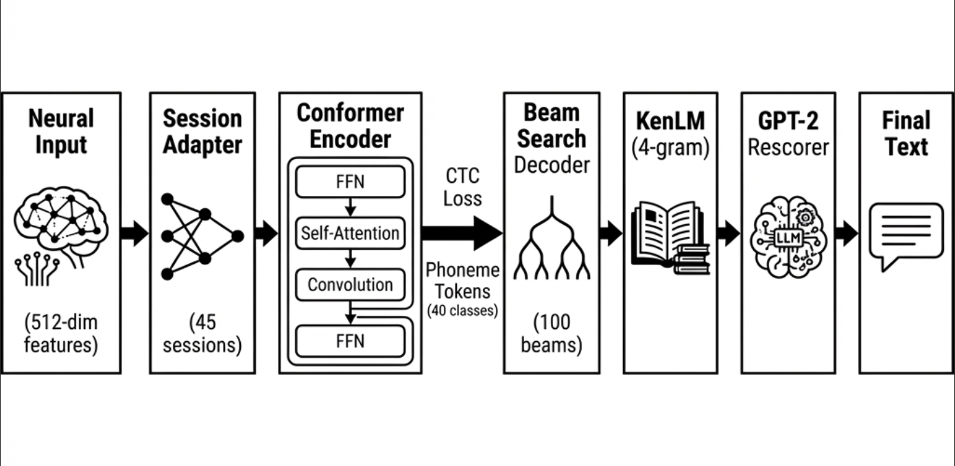
Architecture
September 3, 20XX

Slide 8
Training
Hyperparameter | Value
Optimizer | AdamW (weight_decay=0.01)
LR Schedule | Linear Warmup (10%) + Cosine Annealing
Batch Size | 8 × 4 gradient accumulation = 32 effective
Augmentation | 15% temporal + 15% channel masking
Decoding Pipeline
Conformer Block
Structure
CTC Beam Search (100 beams) → Top-N phoneme sequences
KenLM 4-gram → Scores linguistic plausibility
GPT-2 Rescorer → Reranks using LLM perplexity
Self-Attention: Captures long-range dependencies
Depthwise Conv (kernel=31): Captures local phonetic patterns
Gradient Checkpointing: For memory efficiency
September 3, 20XX

Slide 9
”
Our Secret Sauce…

Slide 10
Multi-Stage Decoding Pipeline
CTC Beam Search → KenLM 4-gram → GPT-2 LLM Rescorer
Not just greedy decoding — 100-beam search with language model guidance
Final LLM rescoring catches semantic errors the n-gram misses
Technique | Implementation | Purpose
Temporal Masking | 15% of timesteps set to 0 | Prevents over-reliance on timing
Channel Masking | 15% of channels set to 0 | Prevents dependence on specific neurons
Gaussian Smoothing | σ=30ms kernel | Reduces spike jitter noise
Time Shift | ±5% for TTA | Test-time augmentation for robustness
September 3, 20XX

Slide 11
Training Optimizations
Optimization | Value
Optimizer | AdamW (weight_decay=0.01)
LR Schedule | 10% Linear Warmup → Cosine Annealing
Gradient Accumulation | 4 steps (effective batch = 32)
Gradient Clipping | max_norm = 1.0
K-Fold CV | 3 folds for robust evaluation
Gradient Checkpointing | Memory-efficient Conformer
Decoding Silent Speech

Slide 12

Thank you
acxjkhckjash
Contoso
sales@contoso.com
September 3, 20XX

